Slide 1
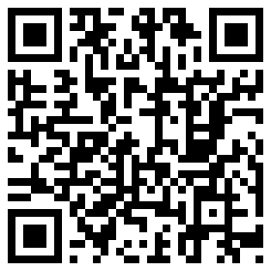


MFL Magic with QR codes

Slide 2
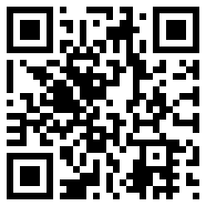
What is a QR code?
QR is short for Quick Response. A QR code is a matrix barcode designed to be read by smartphones. It may contain text, a URL or other data.

Slide 3
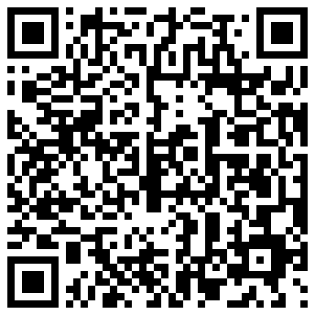
Why?
It’s really hard to type URLS into a phone accurately!
http://www.1jour1actu.com/planete/bientot-de-nouvelles-lois-pour-reglementer-les-oceans-15894/
Or ?

Slide 4
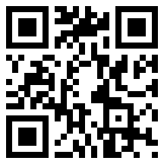
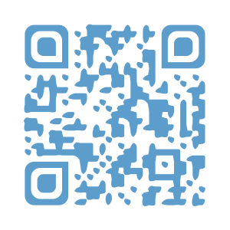
Essential kit: QR converter and QR reader
Use a URL to QR converter website like QR Kaywa.
Copy and paste your URL in to the converter.
Generate a QR code.
Copy and paste the QR image into your document or save it to a file. (Remember to label it so you know what it is)
QR code reader: i-nigma, Neoreader.
Scan the QR code – the reader opens the webpage.

Slide 5
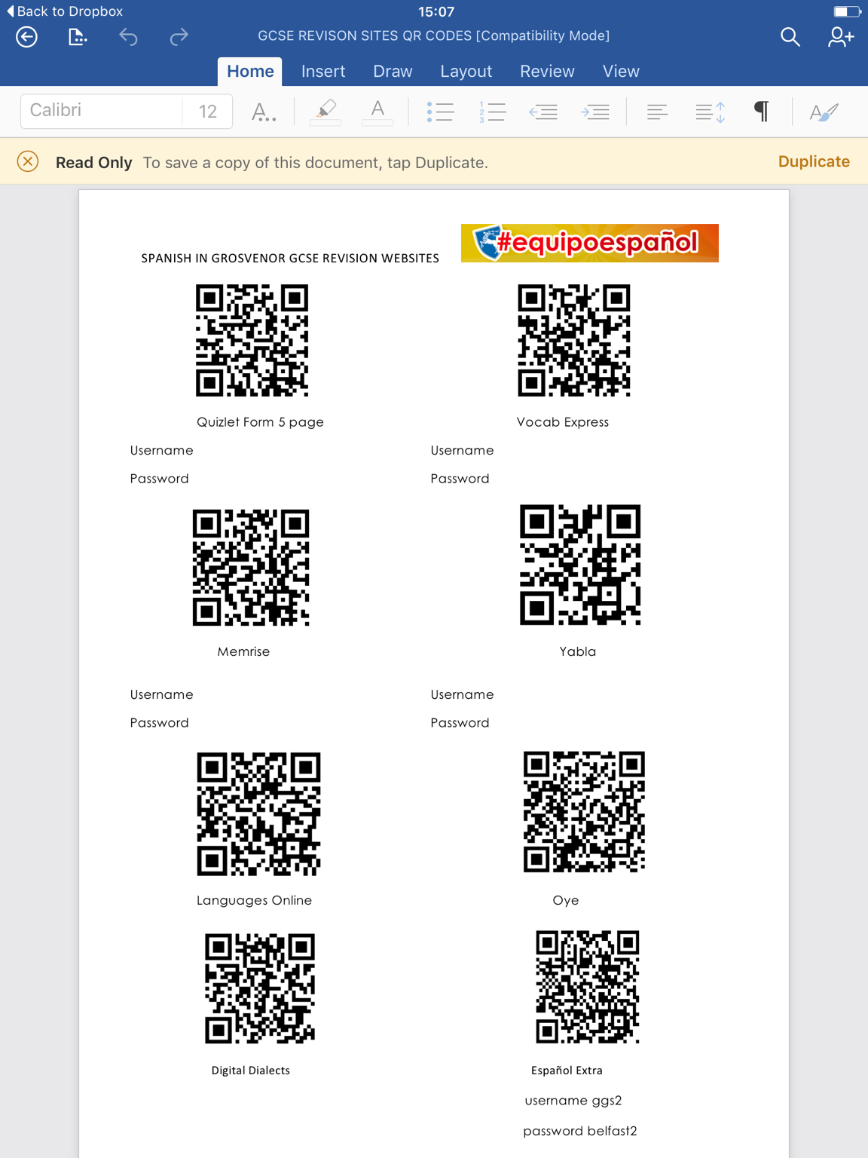

Slide 6
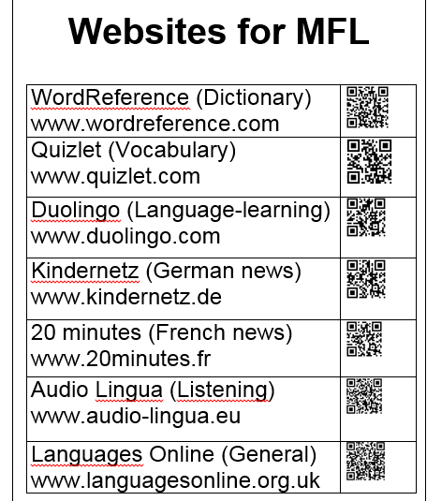
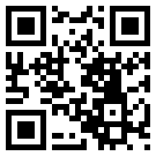
Reference posters
Links on whiteboard
http://newsmap.jp/

Slide 7
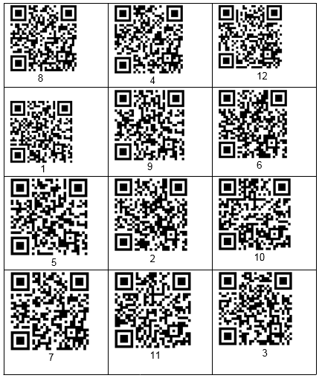
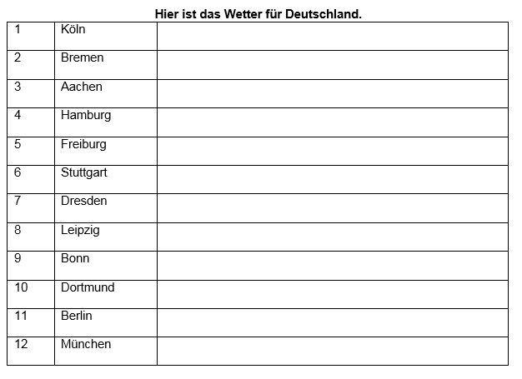
Year 7 project, das Wetter
Objective: to produce a weather report.
Task 1: Listening scavenger hunt.
Made with Vocaroo.

Slide 8
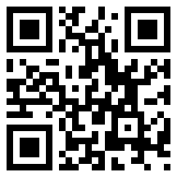
Using Vocaroo – easy to record and share
http://vocaroo.com/
No limit on length of recording.
It will generate a QR code.
But it isn’t saved permanently.

Slide 9
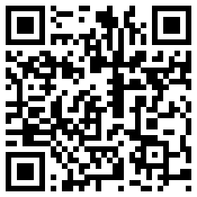
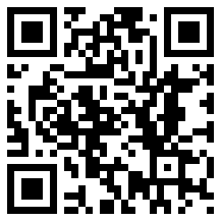
Task 2: Listening from Tellagami (with thanks to Dom)
https://tellagami.com/
Easy tool for recording audio.
Students then made their own.
        Link

Slide 10
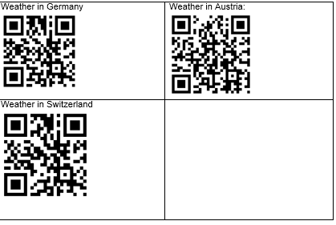
Task 3: Work as a group to produce a weather report
One phone per table.
Scan in each website.
Choose one.
Write a short report.
Present it to the class.
(Click blue spots to demonstrate).
Click the blue spots!

Slide 11
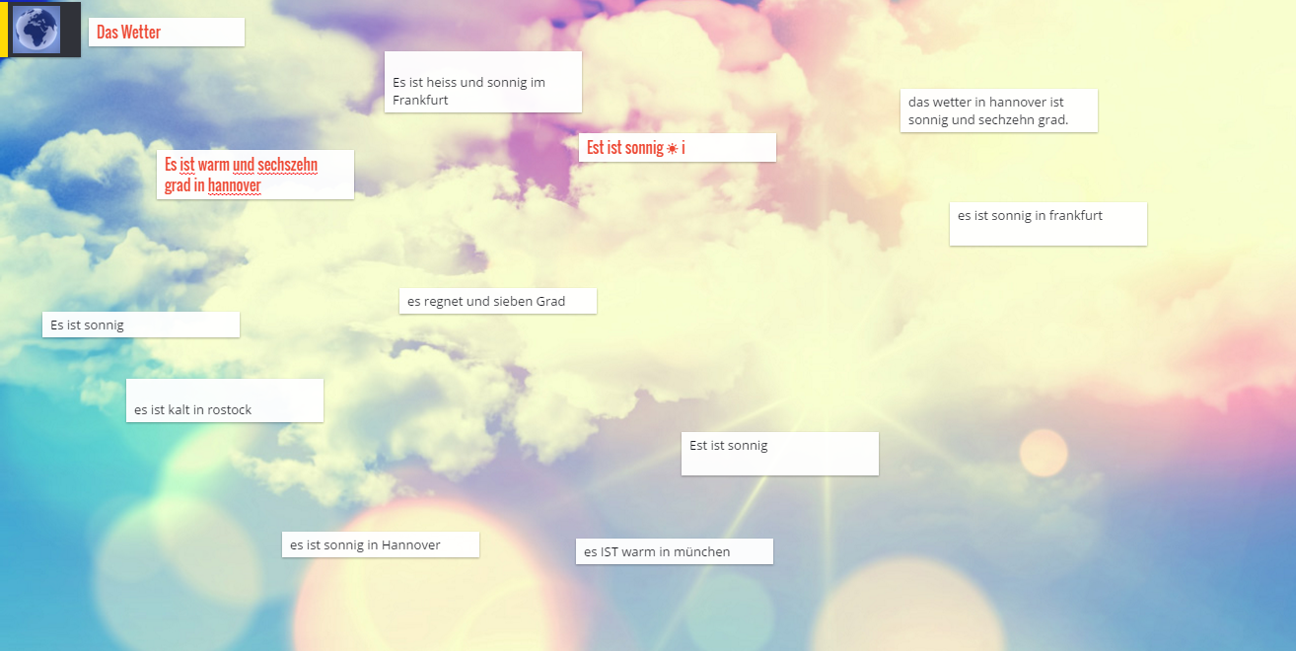
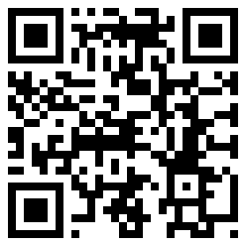
Task 4: Put some key phrases on Padlet
http://padlet.com/MrsAdam/jjddjqwxw84i

Slide 12
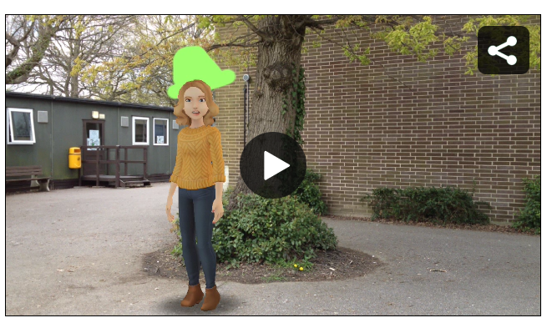
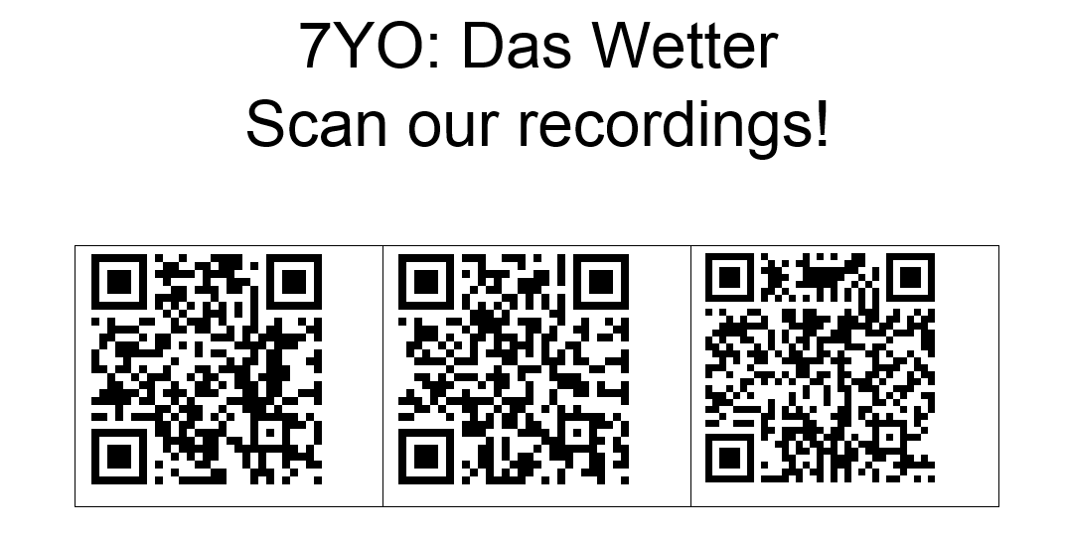
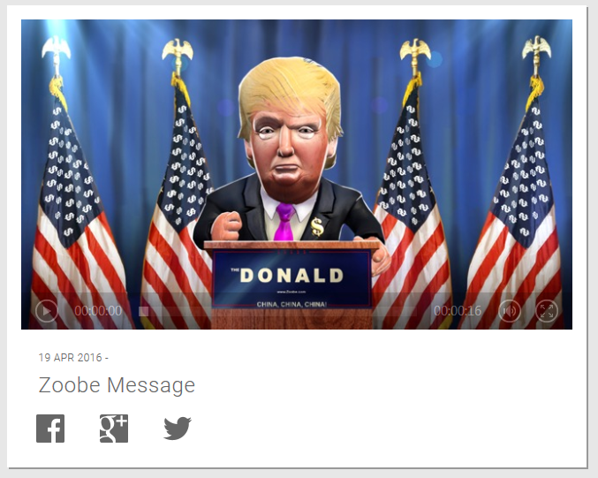
Task 5: Record your weather report – make an interactive display.
https://tellagami.com/gami/NIJQ3I
http://d.zoobe.com/videos/xZxRHKPQIP_1XQeLUWXqeLfGIho

Slide 13
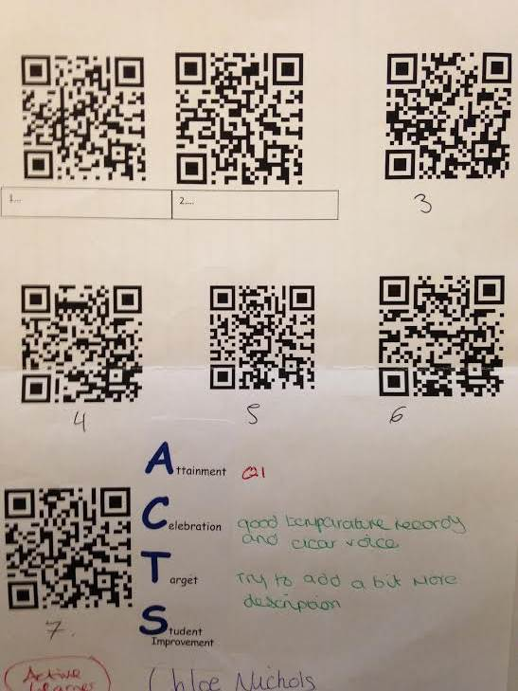
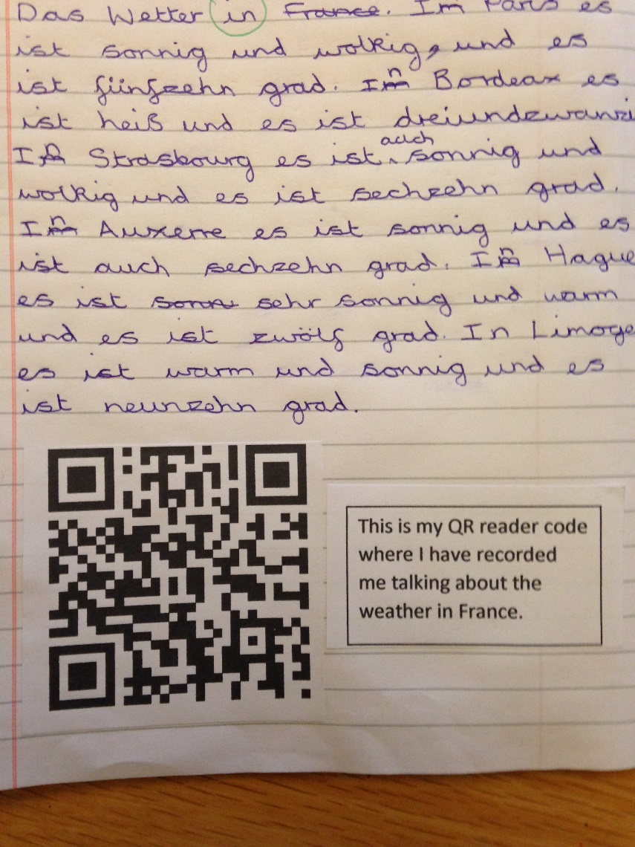
Some homework they produced…

Slide 14
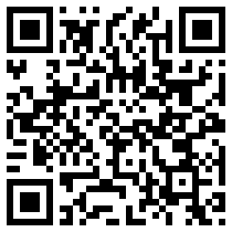
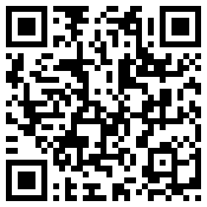
Here’s some Year 8 French…

Slide 15
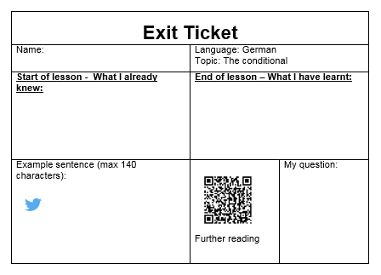
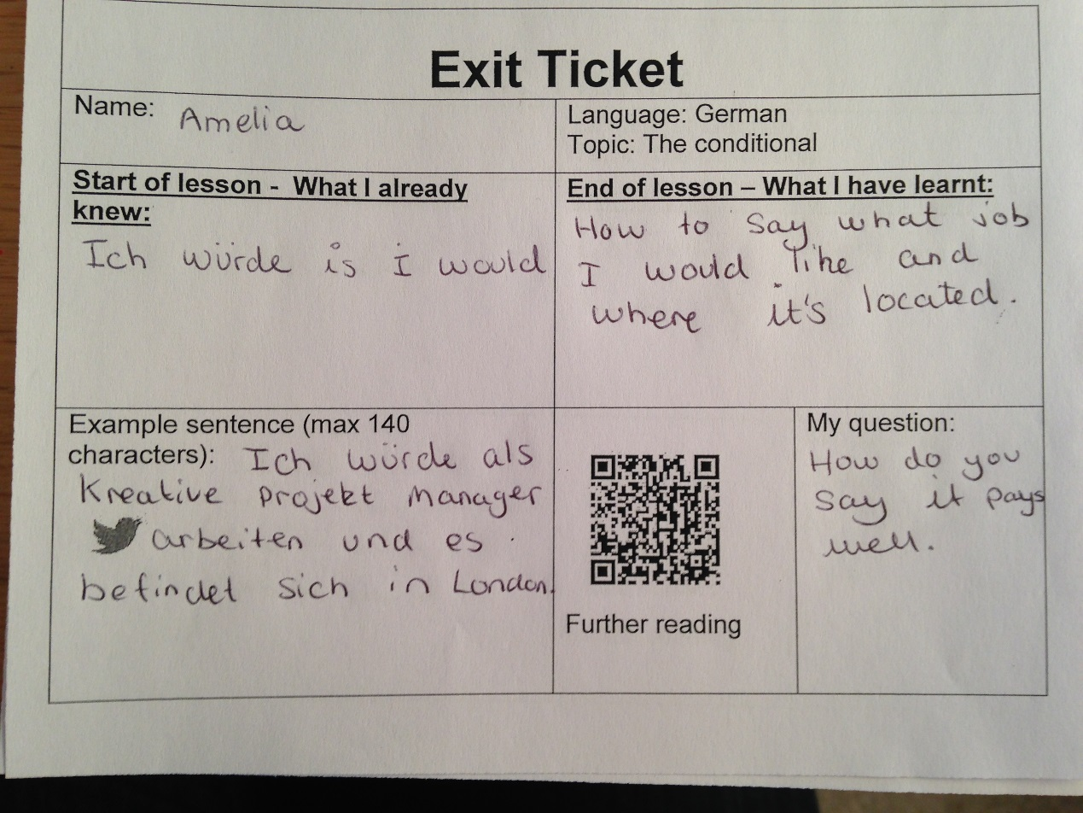
Other ideas: Exit ticket with QR for further resources

Slide 16
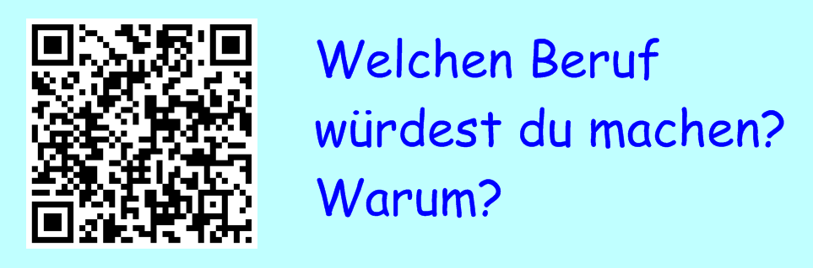
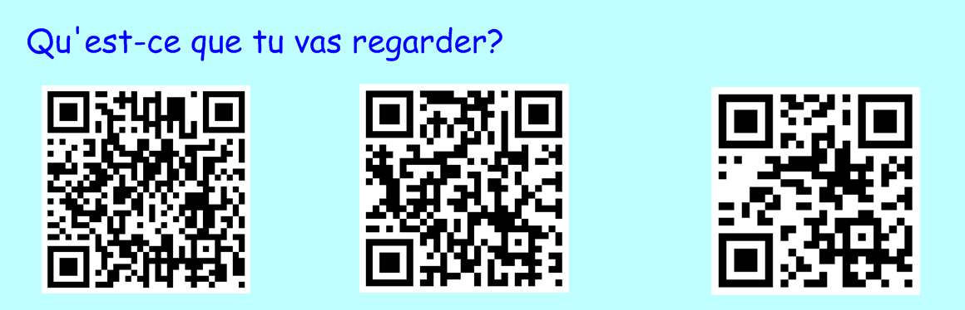
Bring worksheets to life
Link to Guardian jobs with German
Links to French
TV channels

Slide 17
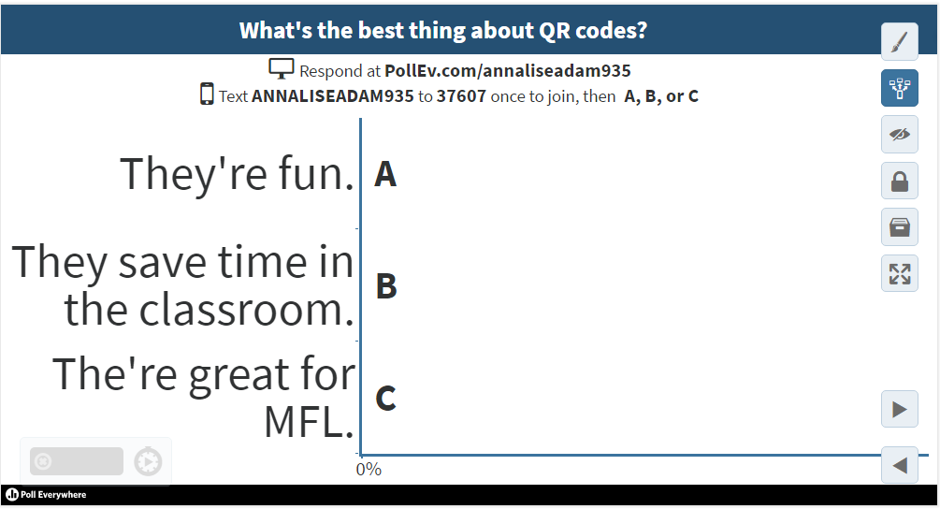
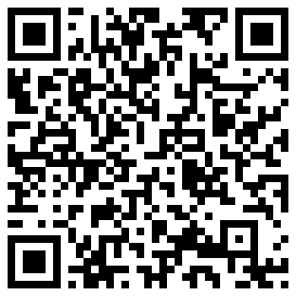
QR codes with Poll Everywhere

Slide 18
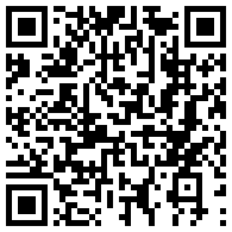
Advanced Project, Year 10: “My local area”
Record something on Voice Record Pro (students or yourself).
Upload it to Dropbox.
Use “share” to generate link.
Copy and paste link into QR converter.
Copy and paste QR code image.
Stick in students’ books.
Self/peer-assessment and teacher comments.
Link:

Slide 19
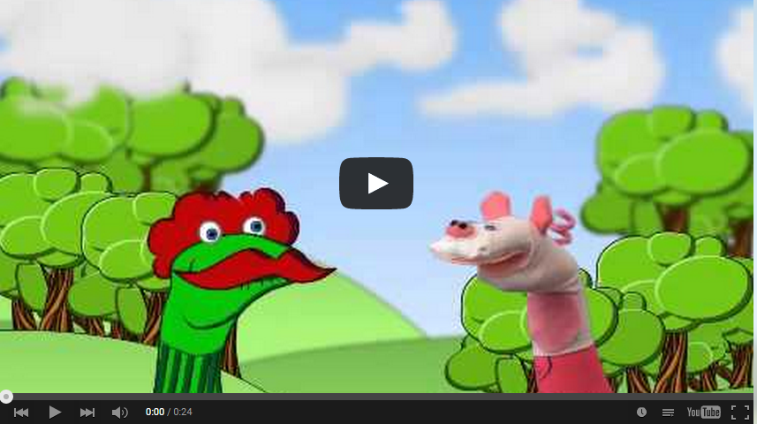
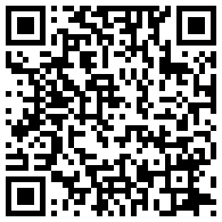
Advanced Project, Year 9: Sock puppets video
Students made animations with Sock Puppets on iPad.
Uploaded to our YouTube channel.
Copied and pasted YouTube link into blog.
Students converted blog URL to QR code & printed it.
Stuck QR code in book as a record of their work.
http://csmfl21.blogspot.co.uk/

Slide 20
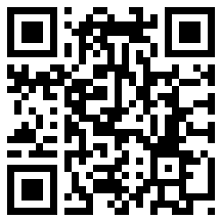
Write on my Padlet! How could you use QR codes in your lessons?
Link

Slide 21
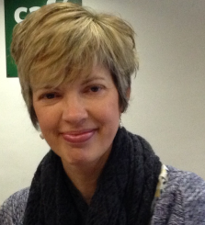
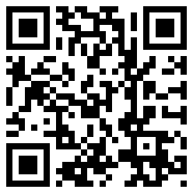
MFL Magic with QR Codes
Annalise Adam
@thwartedmum
mrsacadam.blogspot.co.uk

